Slide 1
AIHA8122 · FRONTIERS IN SMART HEALTHY AGEING
Class 5: Machine learning and Deep learning
Kefeng Li, PhD
E-mail: kefengl@mpu.edu.mo
Office: New Academic Building E1303-1 (Main Campus, Macau);
Bldg 11 Room 206 (Hengqin Campus)
Course webpage: https://canvas.mpu.edu.mo/
Office hours : Wednesday: 10 am -1 pm, and Thursday: 10 am - 1 pm

Slide 2
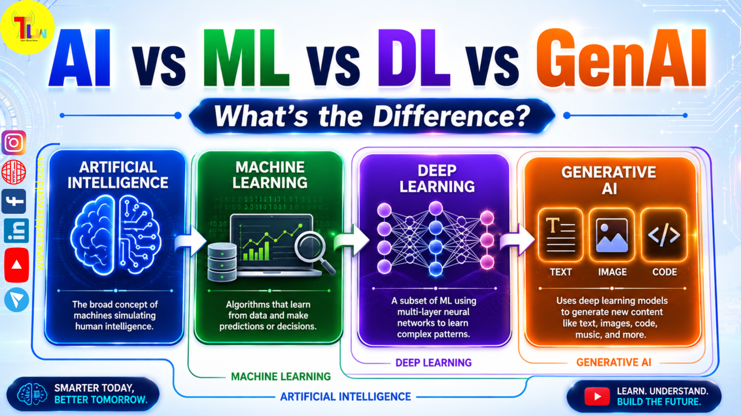
Essential Machine-Learning Language
Machine Learning (ML): A subset of AI where systems learn patterns and make predictions from data instead of hardcoded rules.
Deep learning: A subset of ML using multilayer neural networks to learn complex patterns
Generative AI: Using deep learning models to generate new content like text, images, code, and more.
How do models learn?

Slide 3
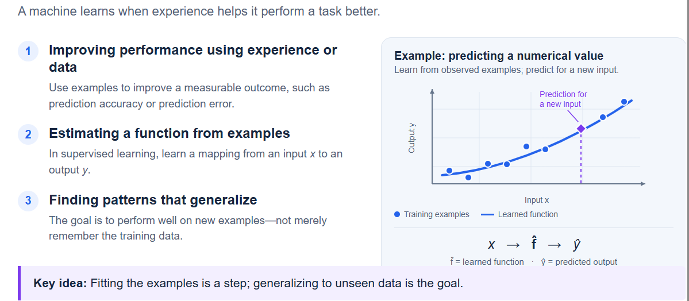
What Does “Learning” Mean?

Slide 4
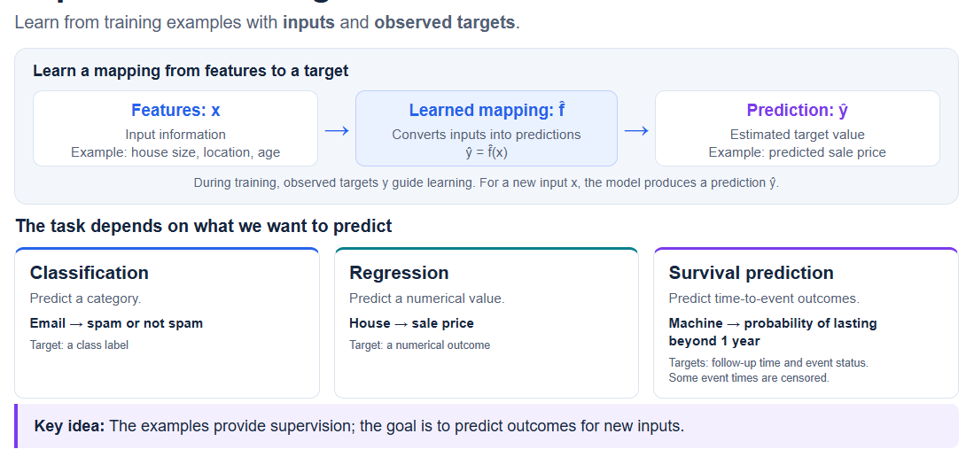
Supervised Learning
Inputs with known outcomes

Slide 5
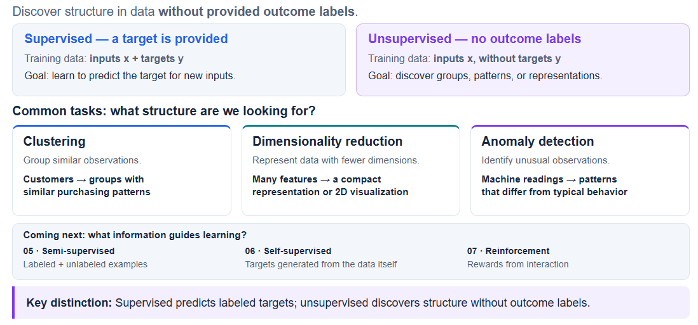
Unsupervised Learning
Notes:
“Unsupervised does not mean the algorithm has no objective—it means we do not supply outcome labels. Also, a task name does not uniquely determine the learning approach: anomaly detection, for example, can be approached with or without labels.”

Slide 6
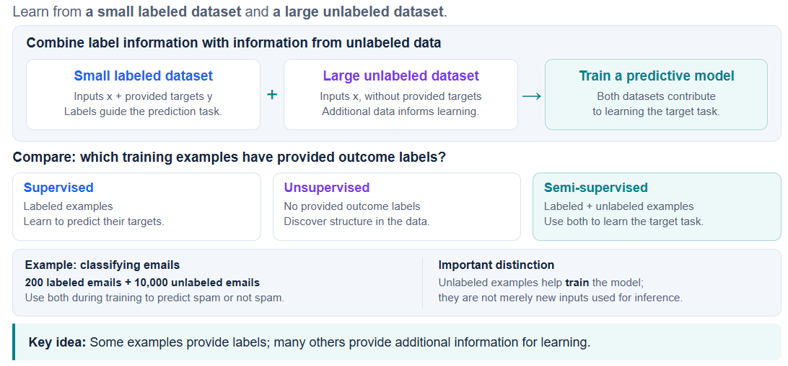
Semi-Supervised Learning
Notes:
One technique is pseudo-labeling: train on labeled examples, generate predicted labels for unlabeled examples, and use selected high-confidence predictions in further training. This is one method—not the definition of all semi-supervised learning.”

Slide 7
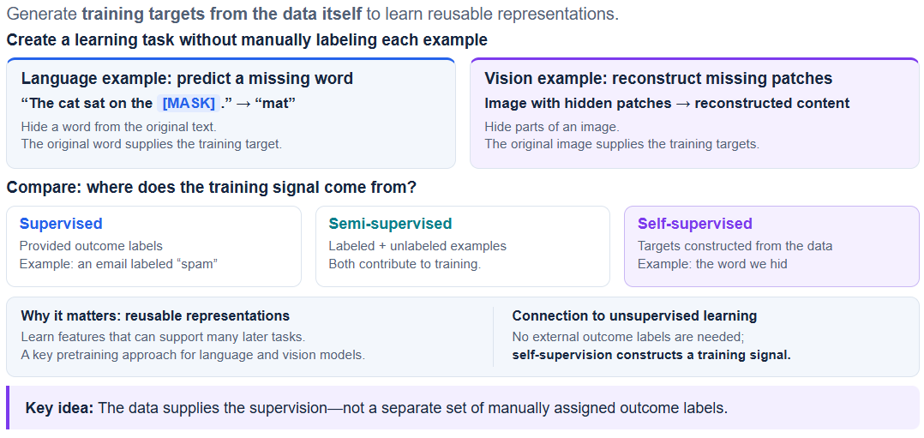
Self-Supervised Learning

Slide 8
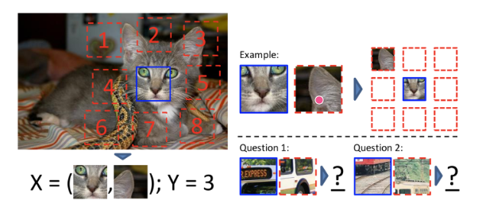
Self-Supervised Learning
Computer vision
Speech recognition
Natural language processing
Self-supervised learning tasks extract multiple patches from one image and ask the model to predict the relationship between these patches.

Slide 9
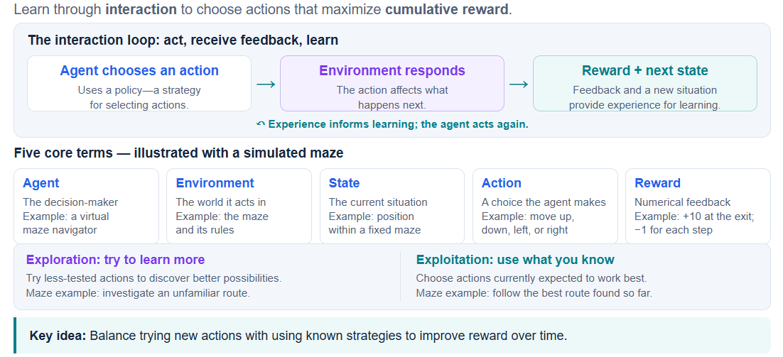
Reinforcement Learning
Notes:
A reward is feedback, not necessarily the correct action. The agent learns a strategy from the consequences of its choices. An action with a small immediate reward may still be valuable if it leads to greater rewards later.”

Slide 10
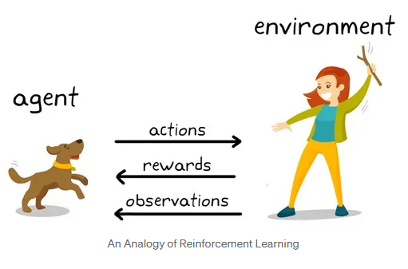
Reinforcement Learning
The analogy of teaching a dog new dog tricks
In this scenario, we emulate a situation and the dog tries to respond in different ways.
If the dog’s response is a desired one, we reward it with dog food.
Else, we convey in one way or the other that its response isn’t the desired one.
It is basically learning what to do from positive experiences.
Similarly, it will tend to learn what not to do when coming face to face with negative experiences.

Slide 11
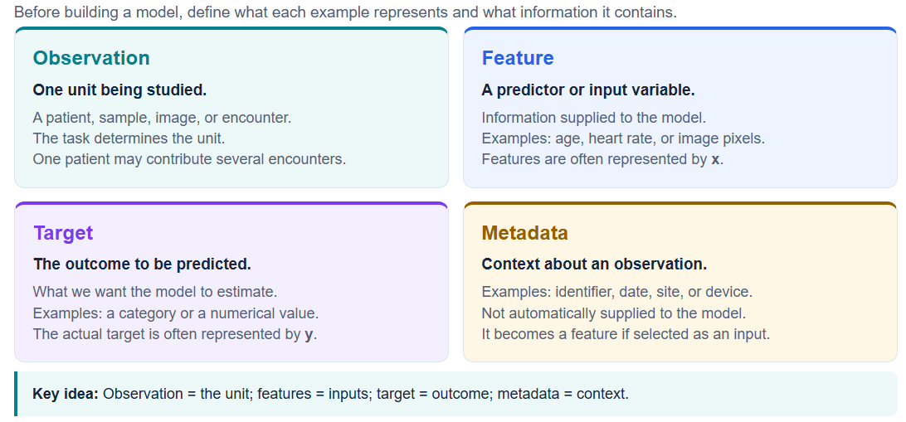
Observations, Features, and Targets
From how models learn to how their data is organized.

Slide 12
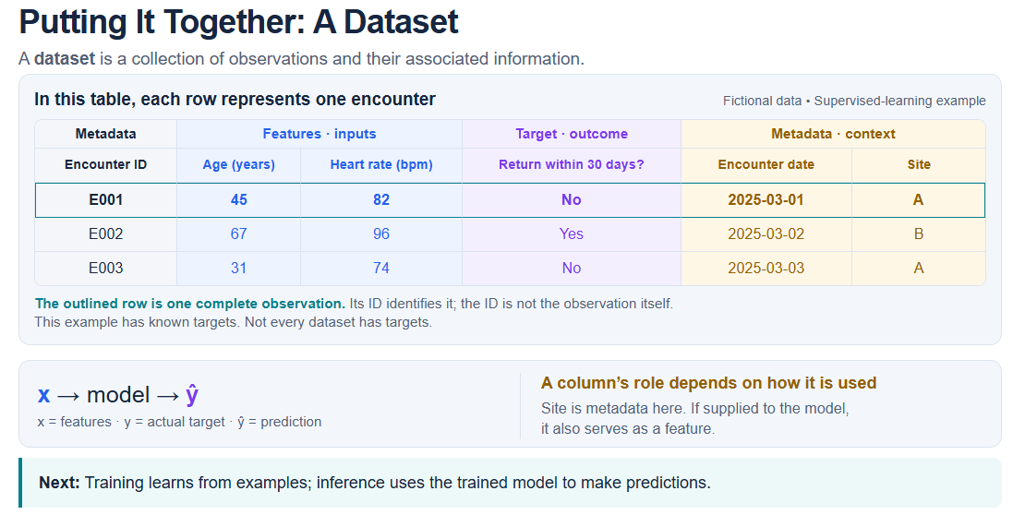
Putting It Together: A Dataset

Slide 13
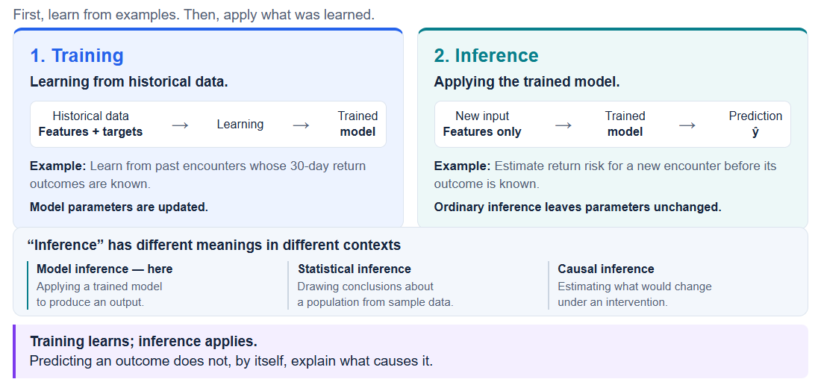
Training and Inference

Slide 14
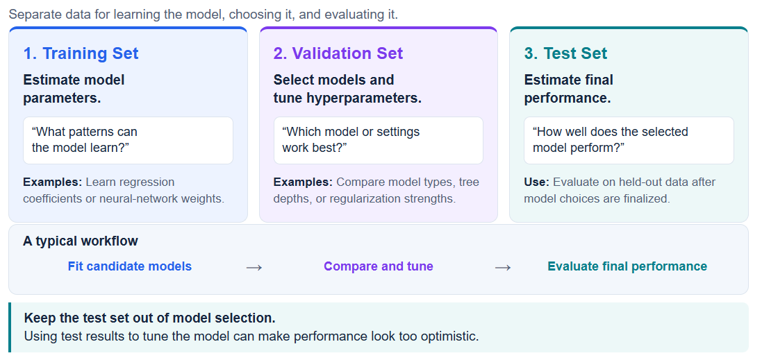
Training, Validation, and Test Sets

Slide 15
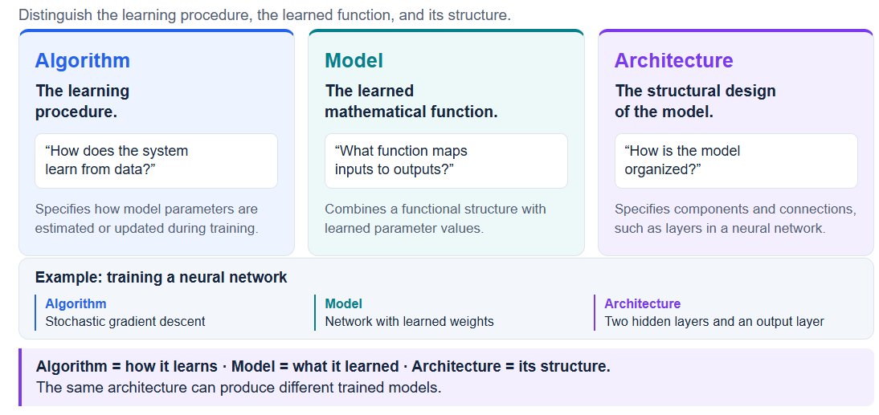
Model, Algorithm, and Architecture

Slide 16
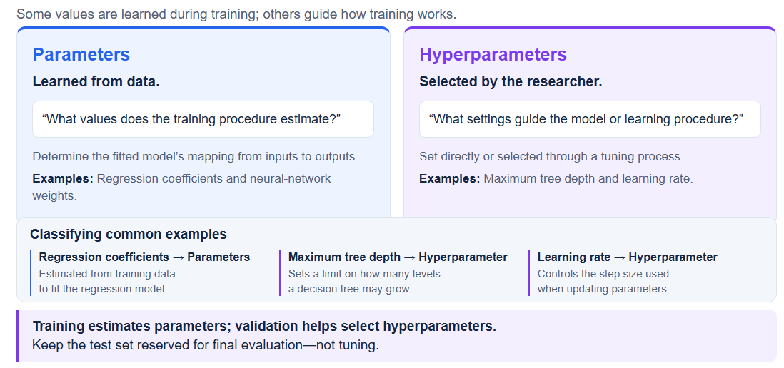
Parameters and Hyperparameters

Slide 17
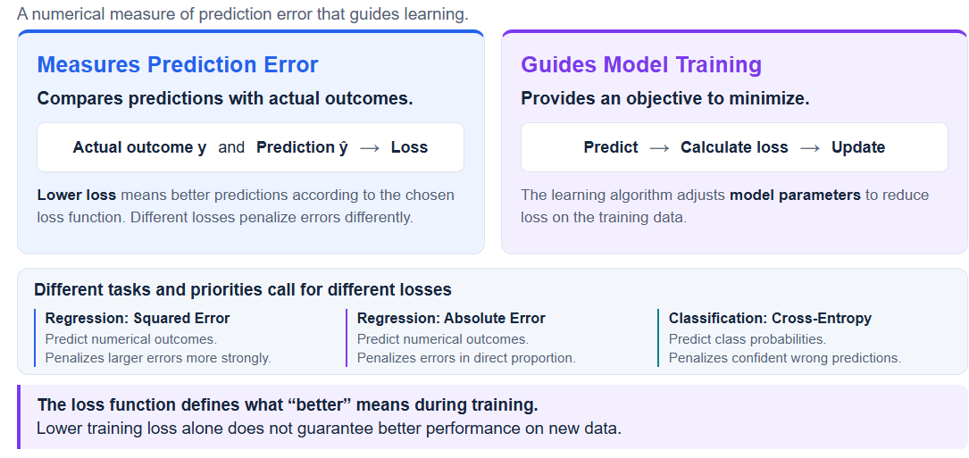
Loss Function

Slide 18
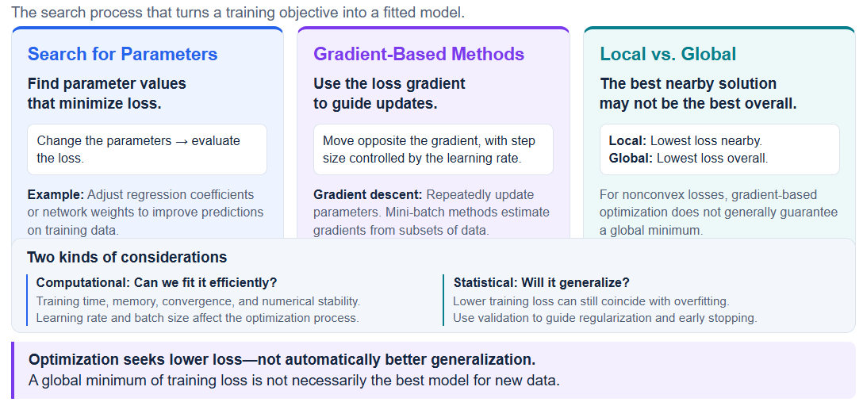
Optimization

Slide 19
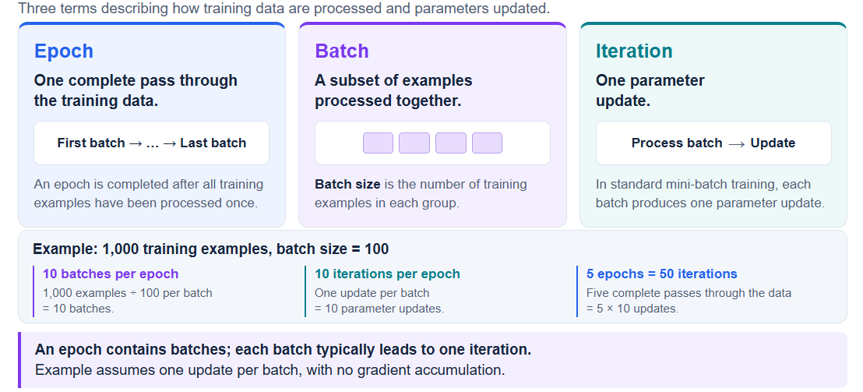
Epoch, Batch, and Iteration
Notes:
由於內存限制或為了優化訓練，我們不能一次性把所有數據塞進電腦，所以會把數據集切分成一個個的小組，這個「小組的大小」就叫做 Batch Size（批次大小）

Slide 20
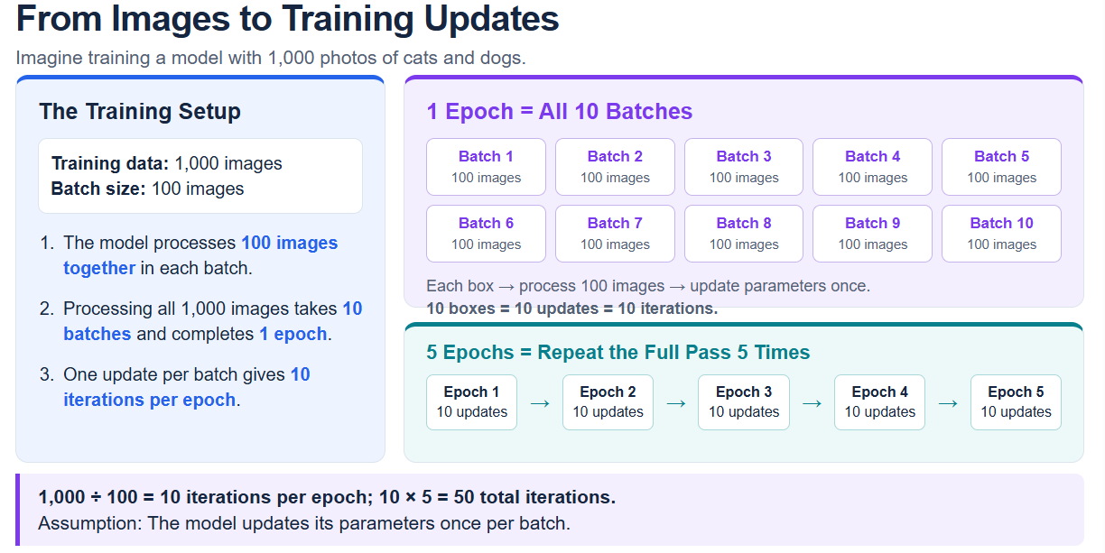
Epoch, Batch, and Iteration
Notes:
由於內存限制或為了優化訓練，我們不能一次性把所有數據塞進電腦，所以會把數據集切分成一個個的小組，這個「小組的大小」就叫做 Batch Size（批次大小）

Slide 21
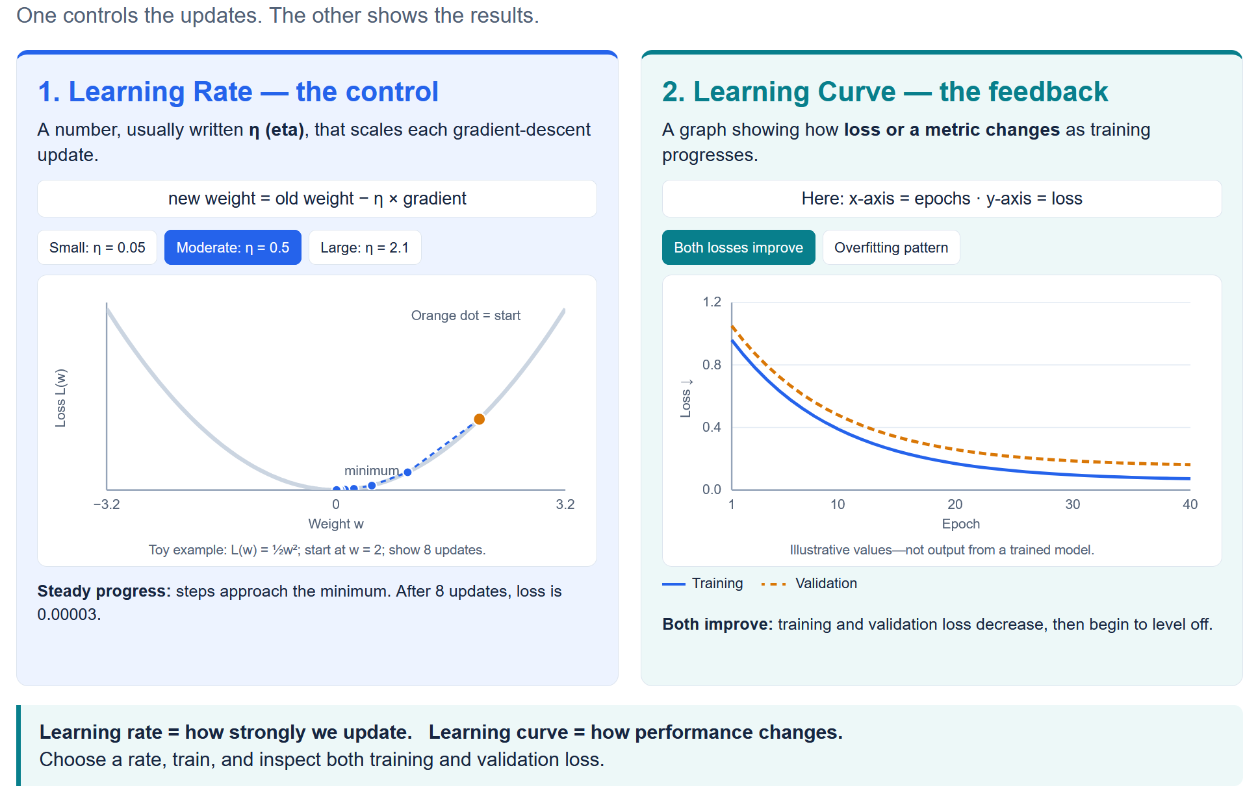
Learning Rate & Learning Curves

Slide 22
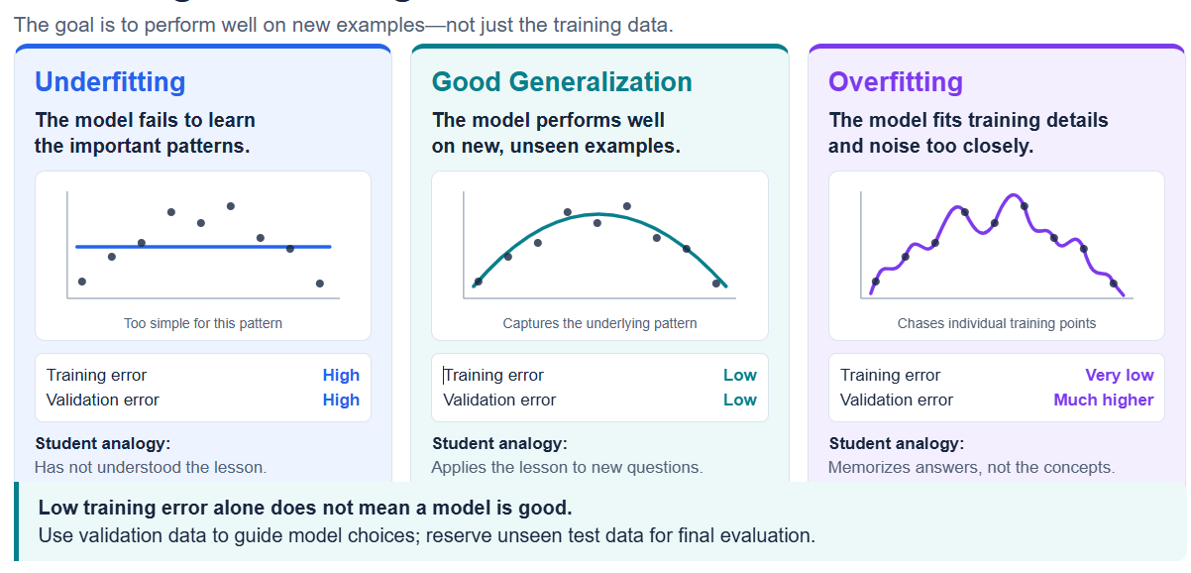
Overfitting, Underfitting, and Generalization
Notes:
由於內存限制或為了優化訓練，我們不能一次性把所有數據塞進電腦，所以會把數據集切分成一個個的小組，這個「小組的大小」就叫做 Batch Size（批次大小）

Slide 23
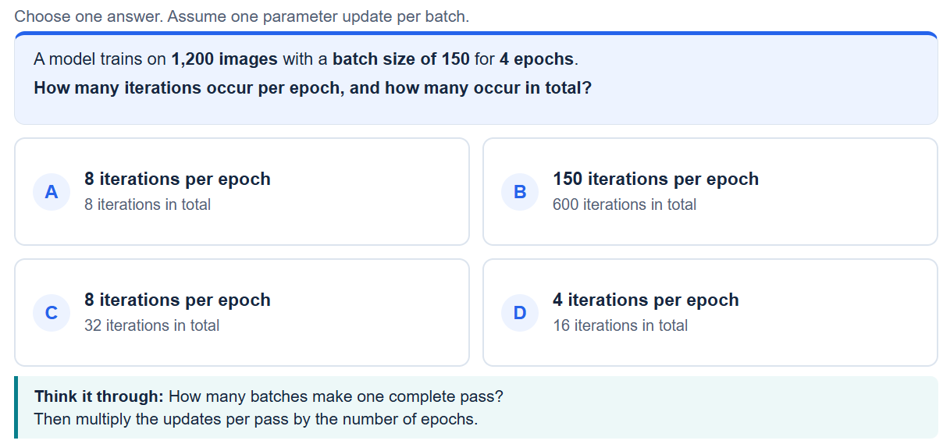
Epoch, Batch, and Iteration
Quiz 1
Notes:
由於內存限制或為了優化訓練，我們不能一次性把所有數據塞進電腦，所以會把數據集切分成一個個的小組，這個「小組的大小」就叫做 Batch Size（批次大小）

Slide 24
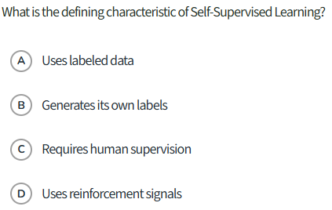
Quiz 2

Slide 25
Quiz 3
During the development of a machine learning model, a data scientist needs to determine the optimal tree depth for a decision tree algorithm. Which dataset should be used to evaluate and select this specific value, and what type of variable is "tree depth"?
A) Training set; Parameter
B) Validation set; Hyperparameter
C) Test set; Hyperparameter
D) Validation set; Parameter
Notes:
由於內存限制或為了優化訓練，我們不能一次性把所有數據塞進電腦，所以會把數據集切分成一個個的小組，這個「小組的大小」就叫做 Batch Size（批次大小）

Slide 26
Quiz 4
Model Fit and Generalization
A student trains a machine learning model to predict housing prices. After training, they notice that the model perfectly predicts the prices of all the houses in the training dataset, achieving nearly zero error. However, when they evaluate the model on a new, unseen test dataset, the predictions are highly inaccurate. Which concept best describes this situation?
A) Underfitting
B) Overfitting
C) Appropriate fit
D) Dimensionality reduction
Notes:
由於內存限制或為了優化訓練，我們不能一次性把所有數據塞進電腦，所以會把數據集切分成一個個的小組，這個「小組的大小」就叫做 Batch Size（批次大小）

Slide 27
AIHA8122 · FRONTIERS IN SMART HEALTHY AGEING
Building a Reliable Machine-Learning Study
Kefeng Li, PhD
E-mail: kefengl@mpu.edu.mo
Office: New Academic Building E1303-1 (Main Campus, Macau);
Bldg 11 Room 206 (Hengqin Campus)
Course webpage: https://canvas.mpu.edu.mo/
Office hours : Wednesday: 10 am -1 pm, and Thursday: 10 am - 1 pm

Slide 28
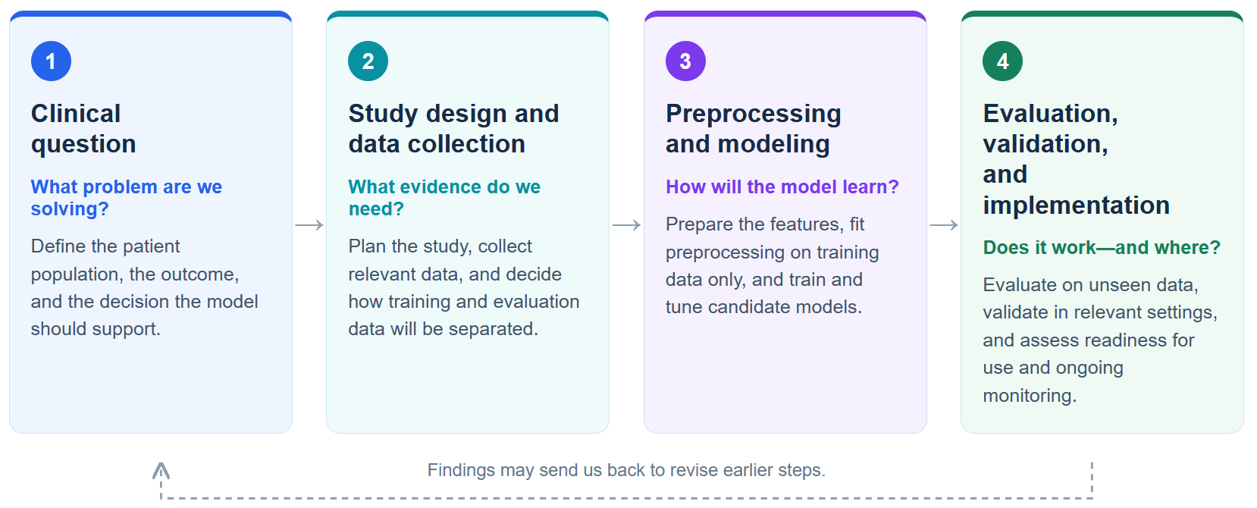
The End-to-End ML Workflow
From a clinical question to a model that can be evaluated and used responsibly.

Slide 29
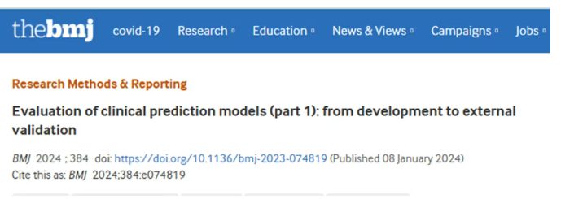
The End-to-End ML Workflow
Two guidelines
TRIPOD+AI （For manuscript writing)
PROBAST+AI (For method check

Slide 30
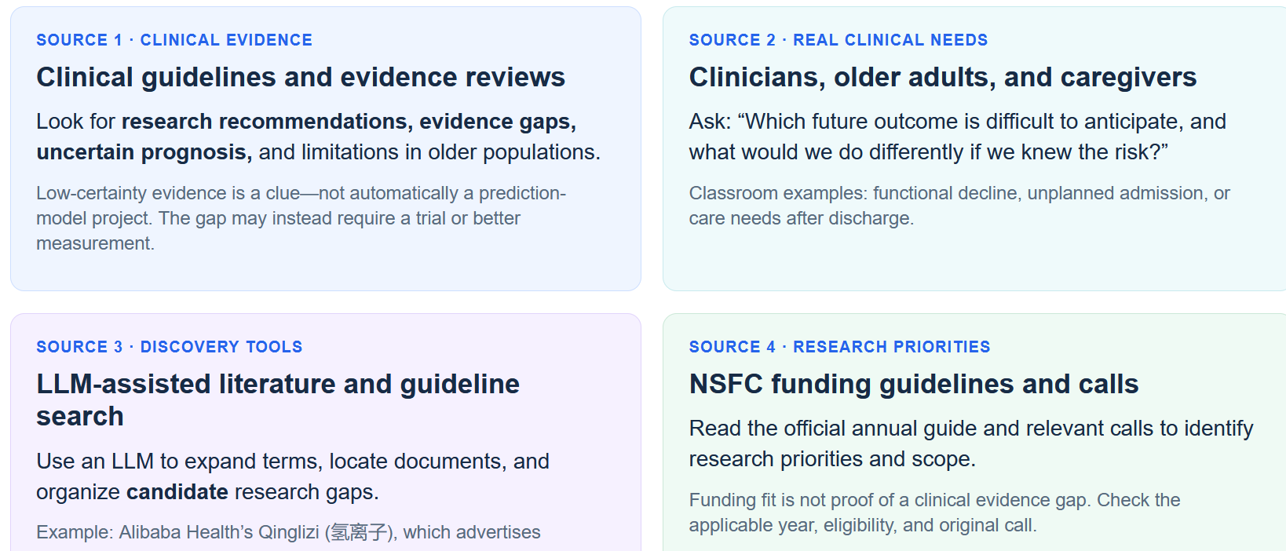
Where Do I Find Clinical Questions

Slide 31

Where Do I Find Clinical Questions
https://www.ali-doctor.com/

Slide 32
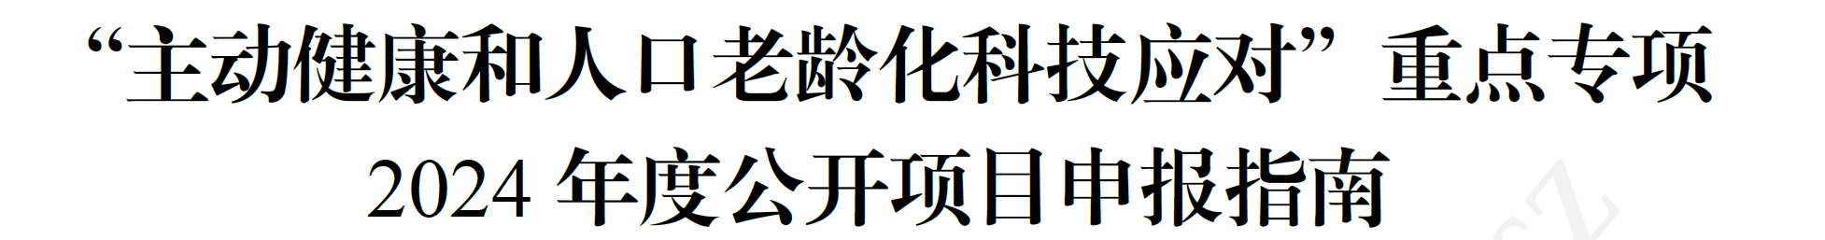
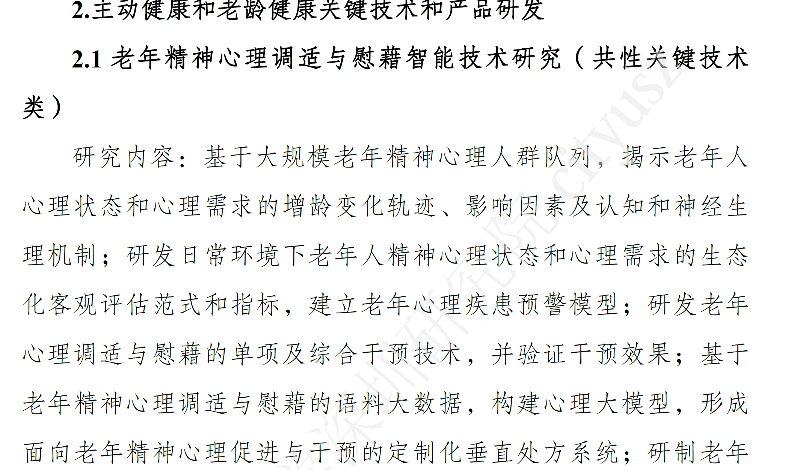
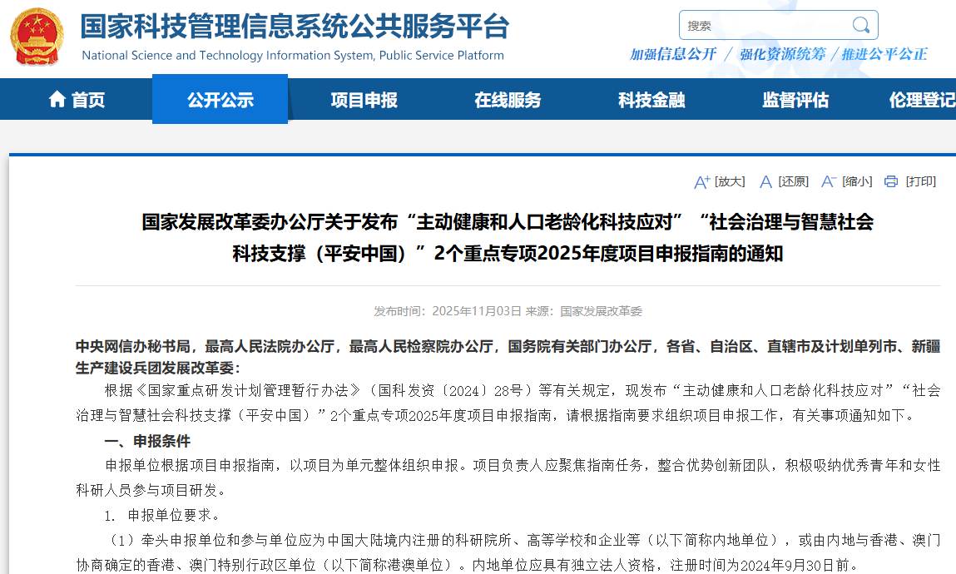
Where Do I Find Clinical Questions
National Key R&D Program Project

Slide 33
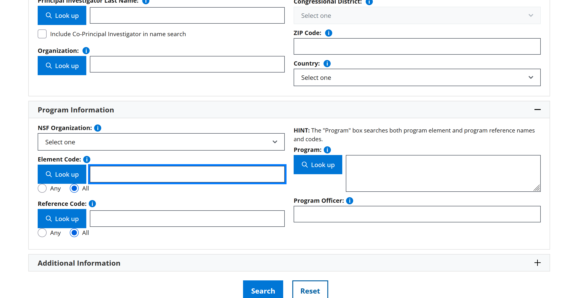
Where Do I Find Clinical Questions
NIH and NSF websites from USA
https://www.nsf.gov/awardsearch/simple-search/

Slide 34
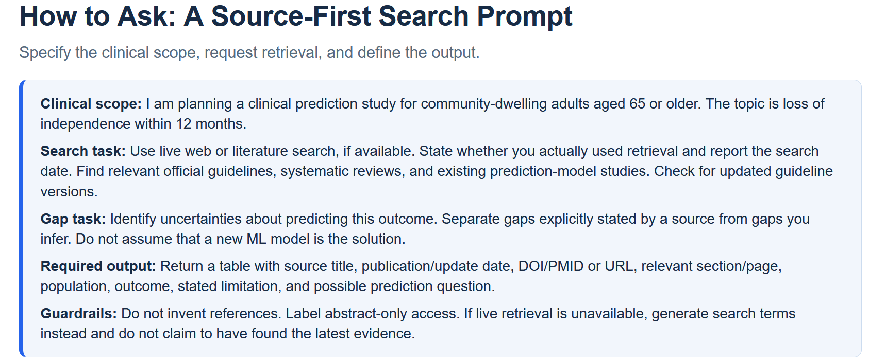
Where Do I Find Clinical Questions

Slide 35
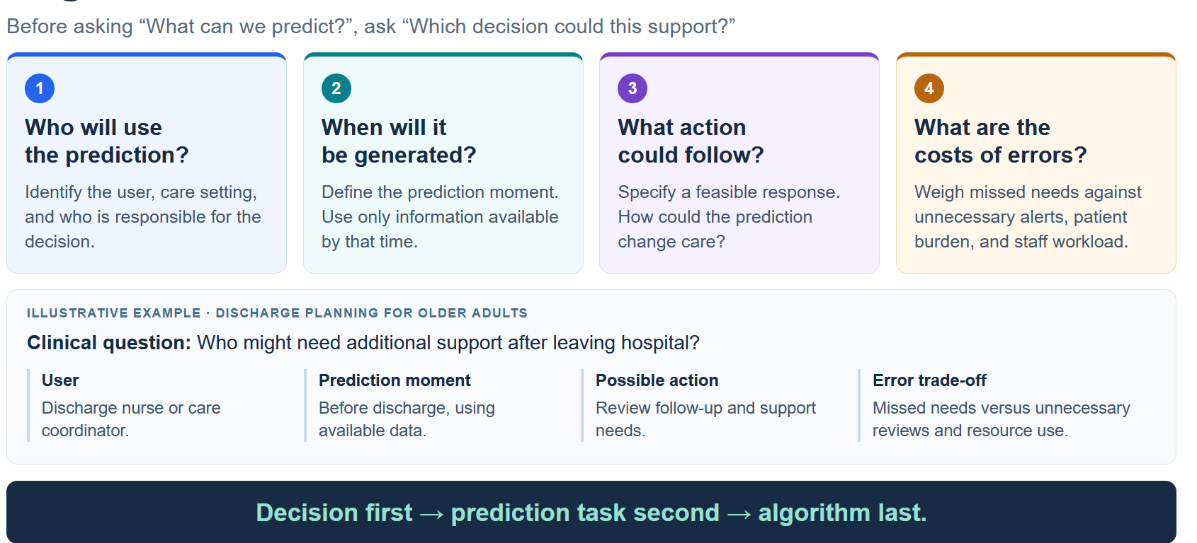
Begin with the Decision
Teaching example: prediction accuracy alone does not prove that an action improves outcomes.

Slide 36
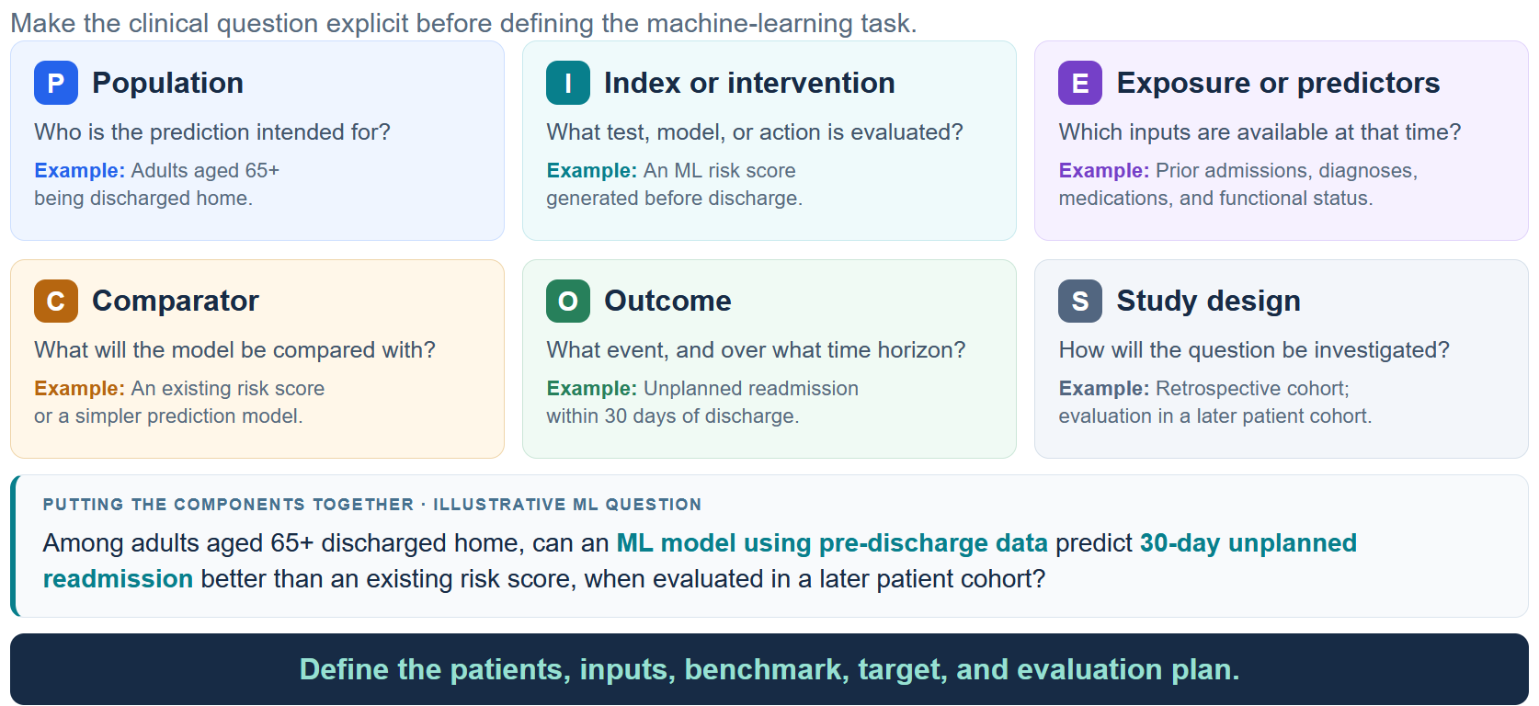
PIECES/PIECOS Framework

Slide 37
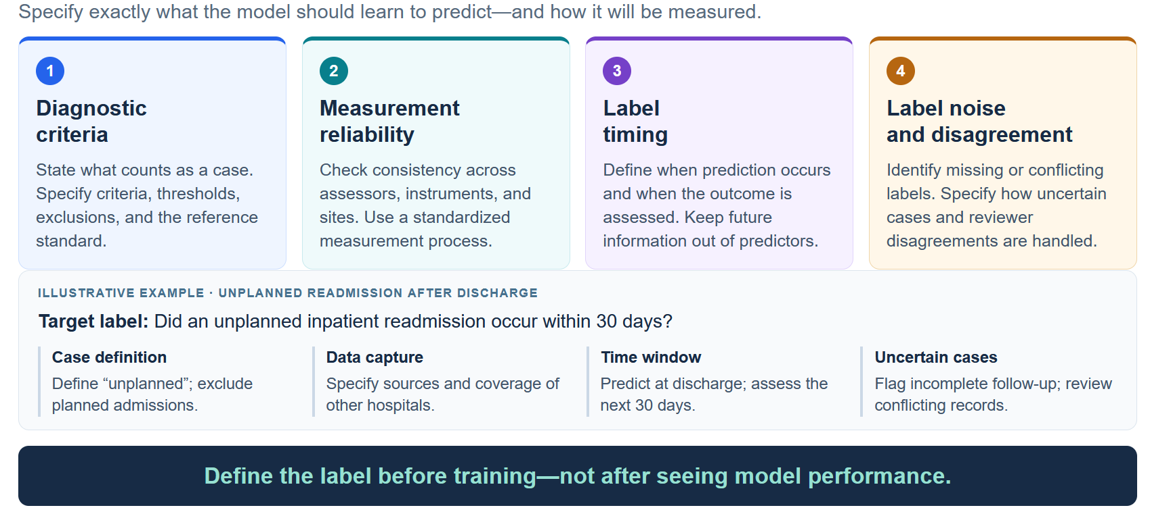
Defining the Target Label

Slide 38
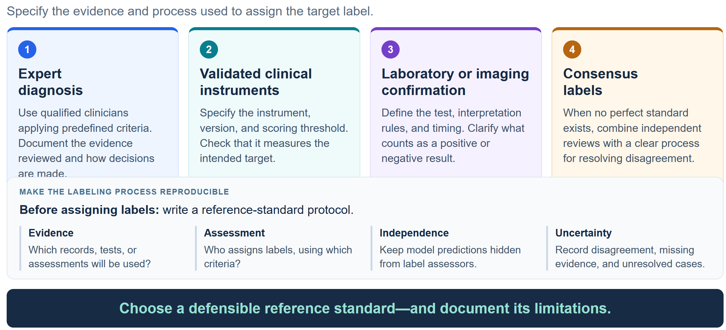
Reference Standards

Slide 39
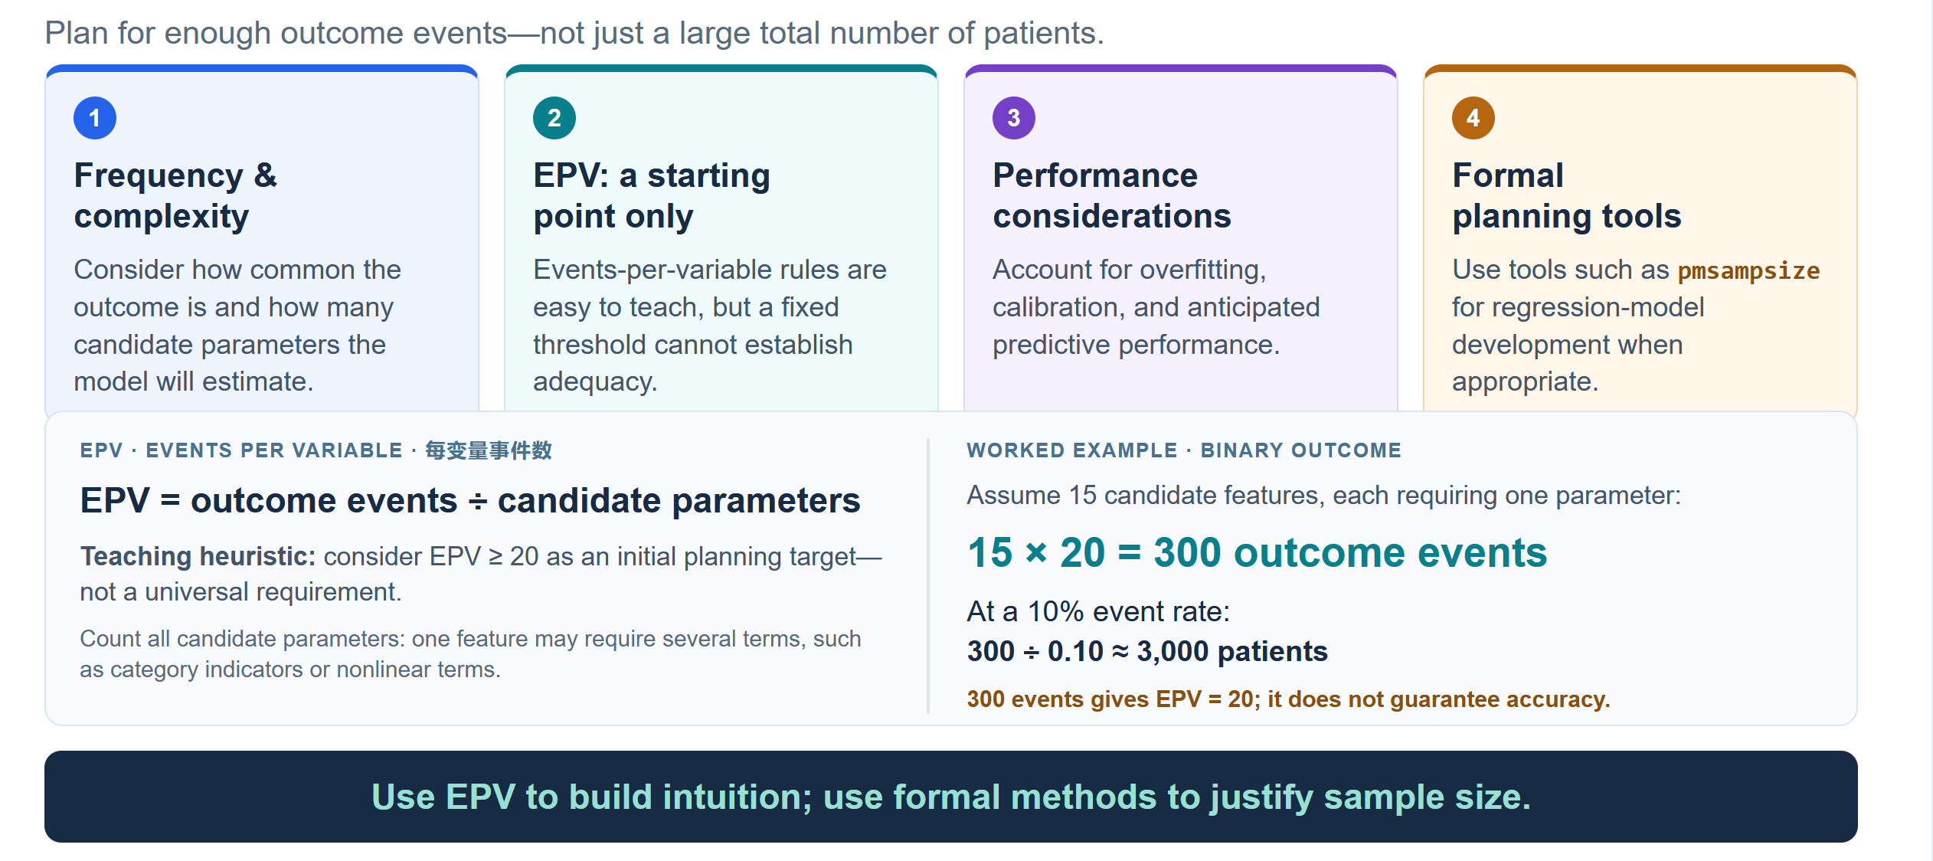
Sample Size for Prediction Models

Slide 40
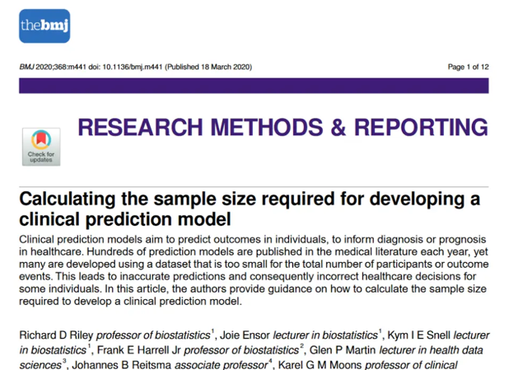
Sample Size for Prediction Models

Slide 41
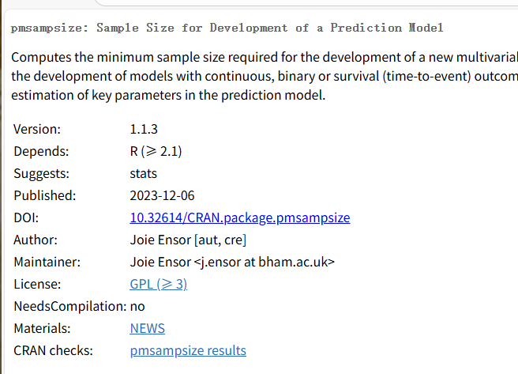
Sample Size for Prediction Models
pmsampsize: Sample Size for Development of a Prediction Model

Slide 42
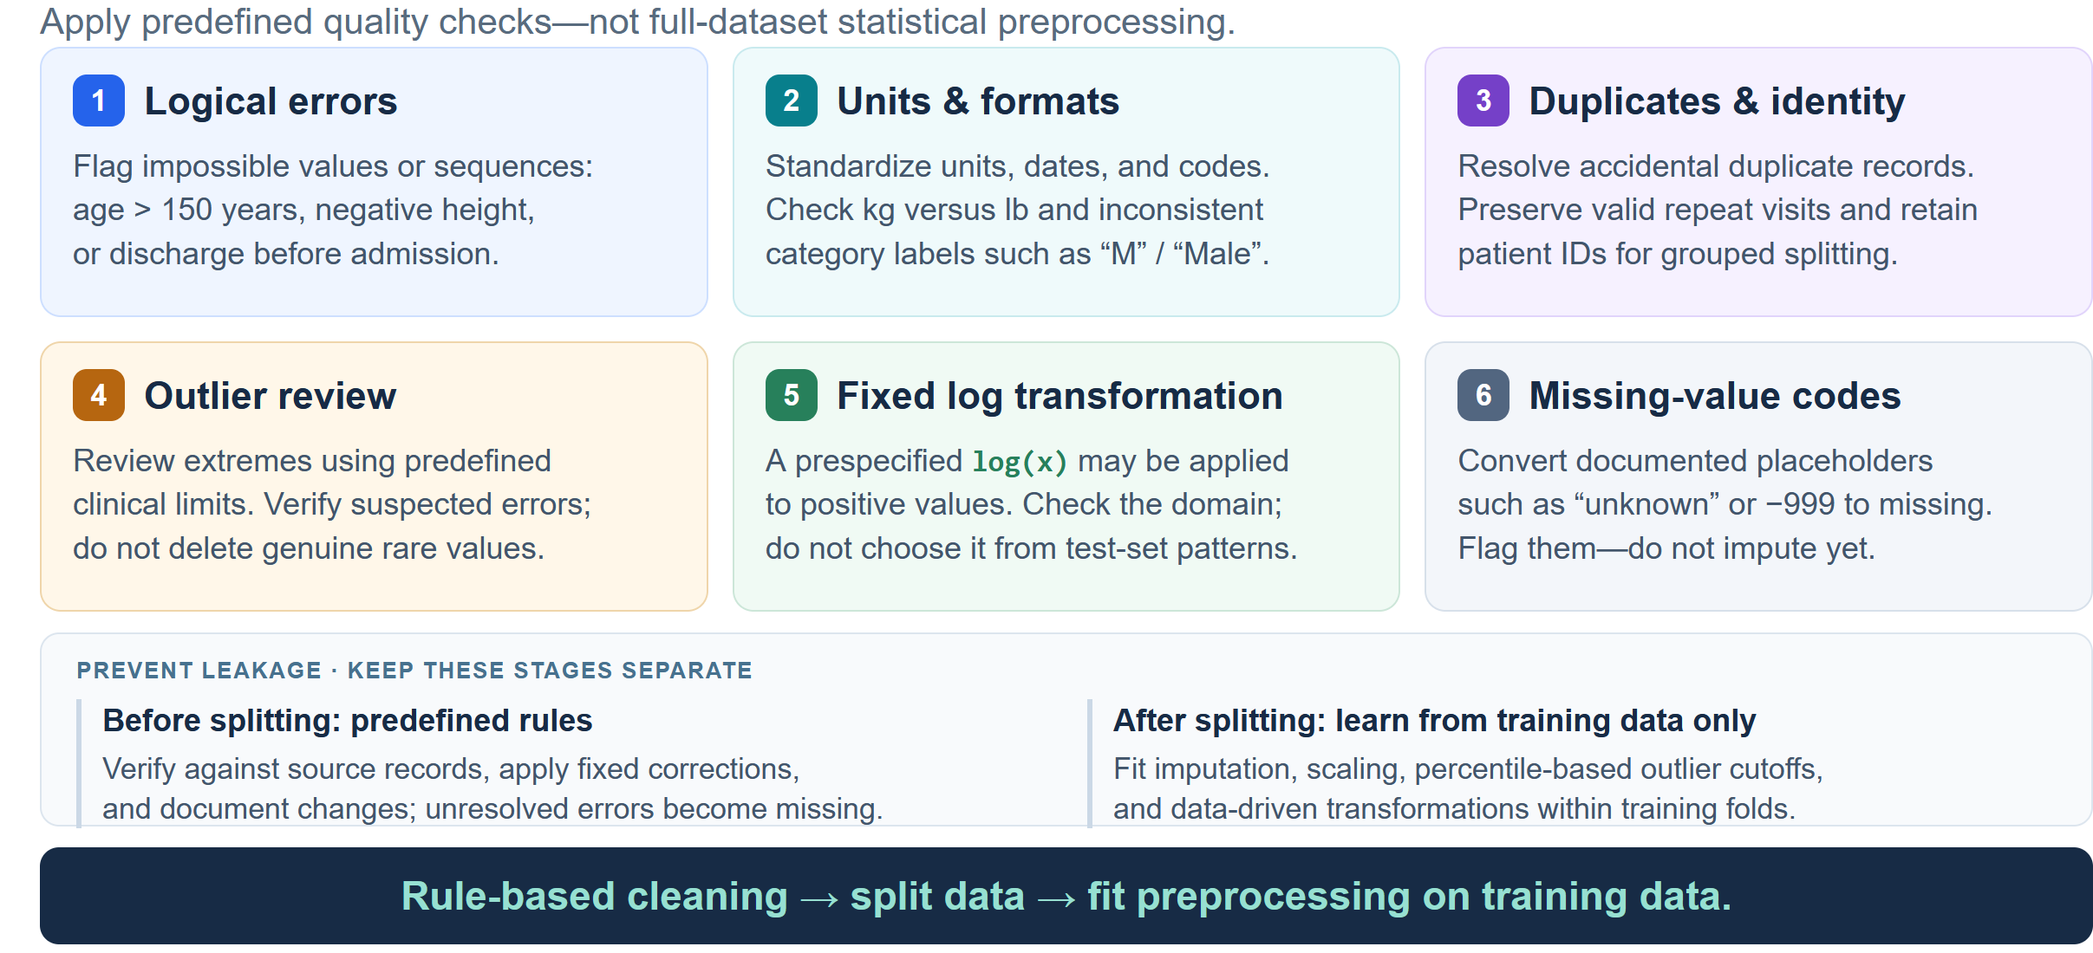
Data Cleaning Before Splitting
Predefined data-quality checks from preprocessing learned from data, which should be fitted only on training data to avoid leakage.

Slide 43
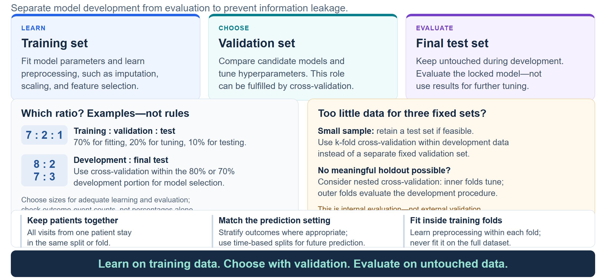
Split the Data Before Learning from It

Slide 44
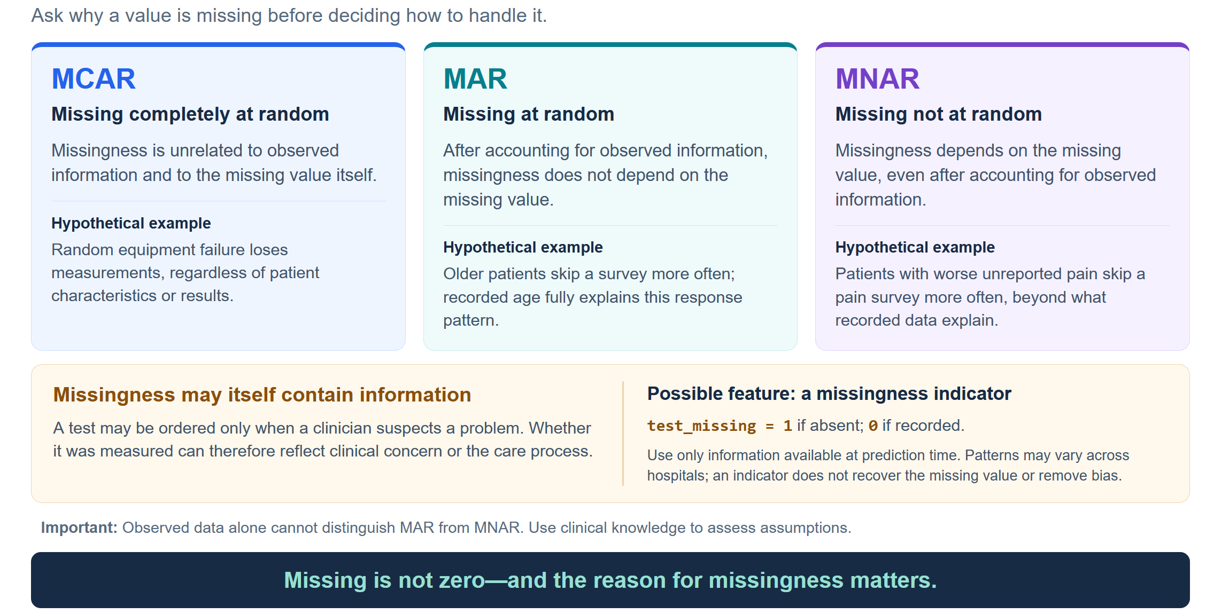
Understanding Missing Data

Slide 45
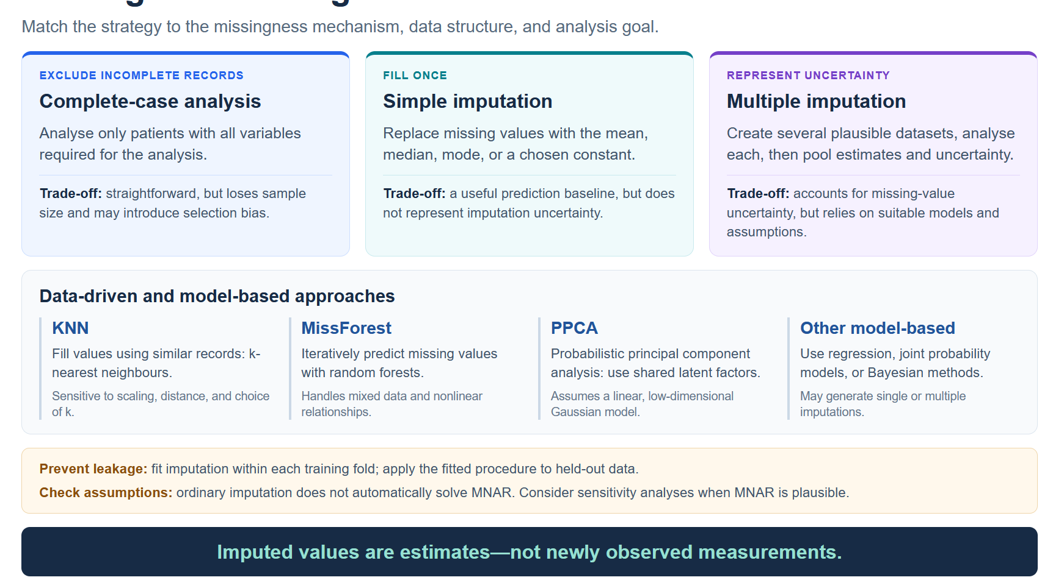
Missing-Data Strategies

Slide 46
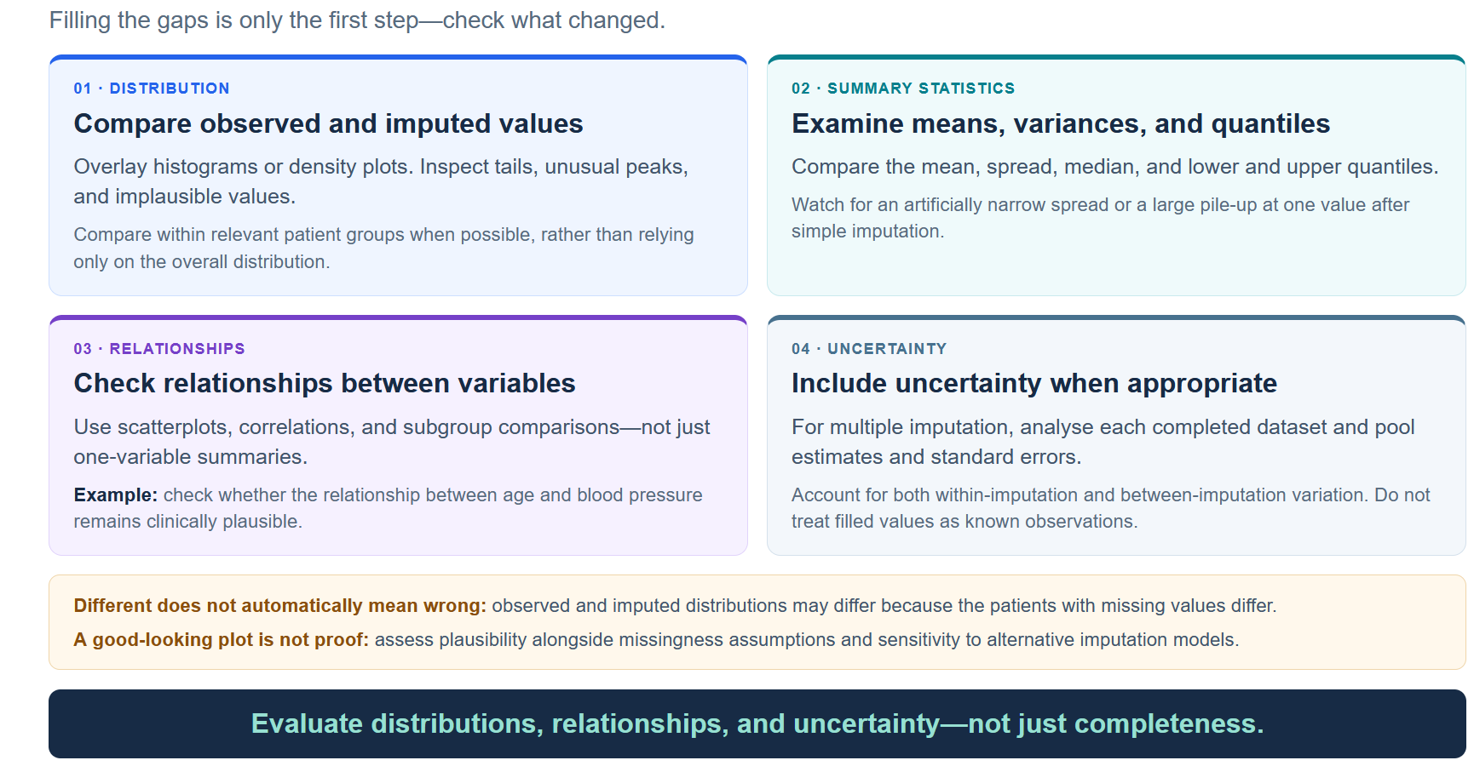
Evaluating Imputation

Slide 47
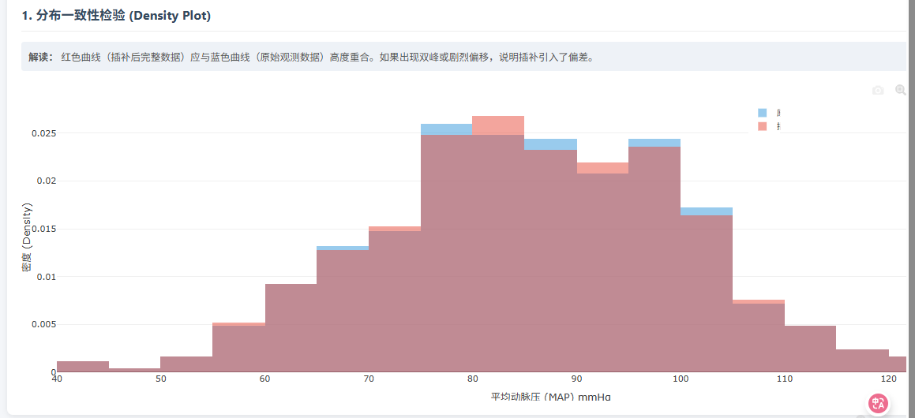
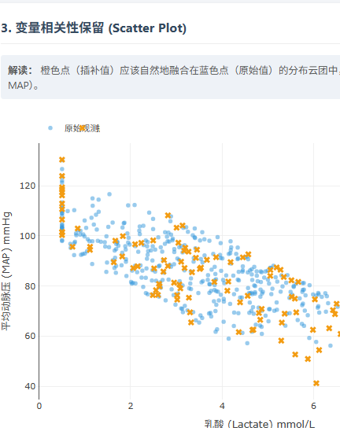
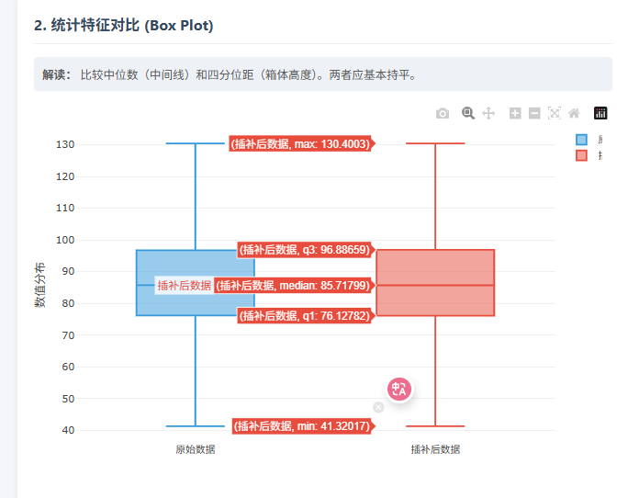
Evaluating Imputation

Slide 48
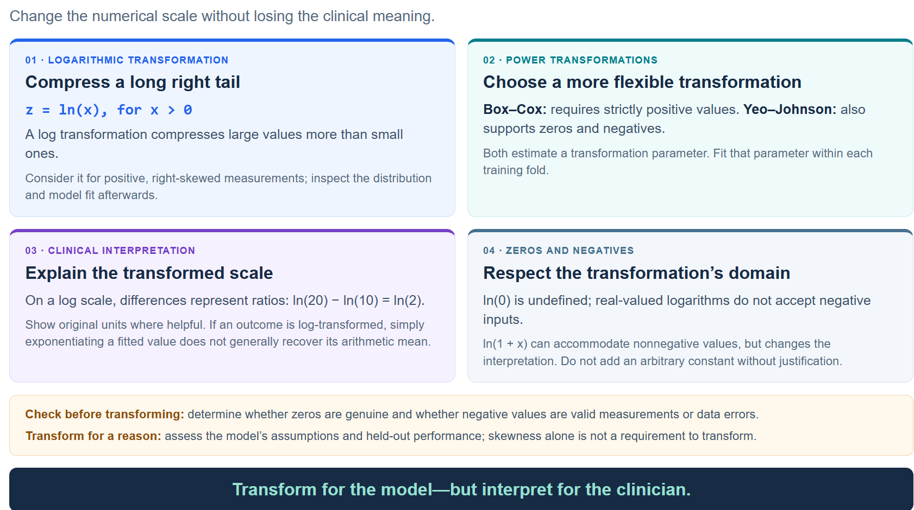
Transforming Skewed Variables

Slide 49
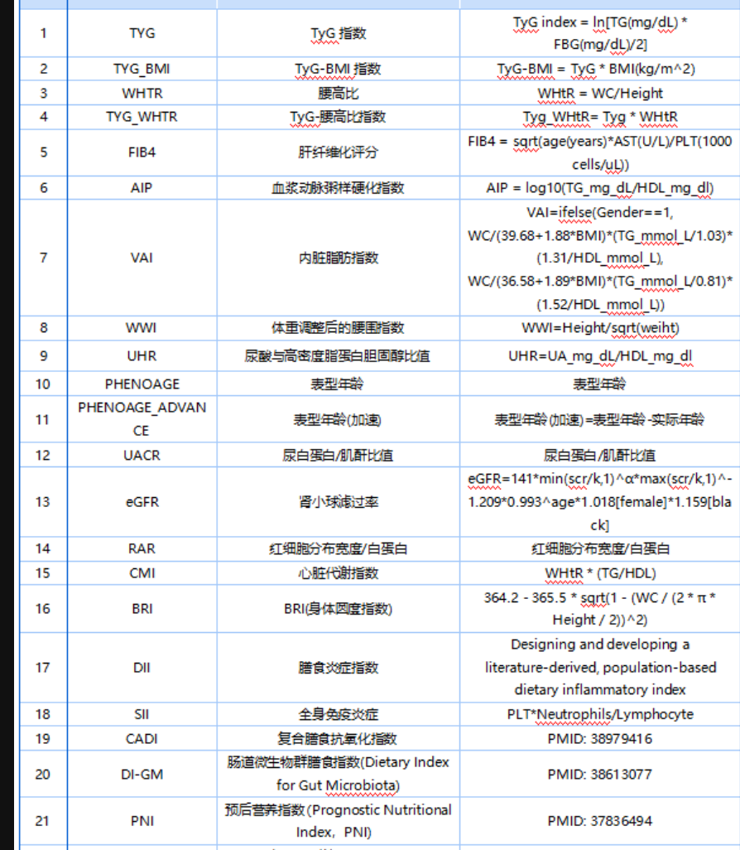
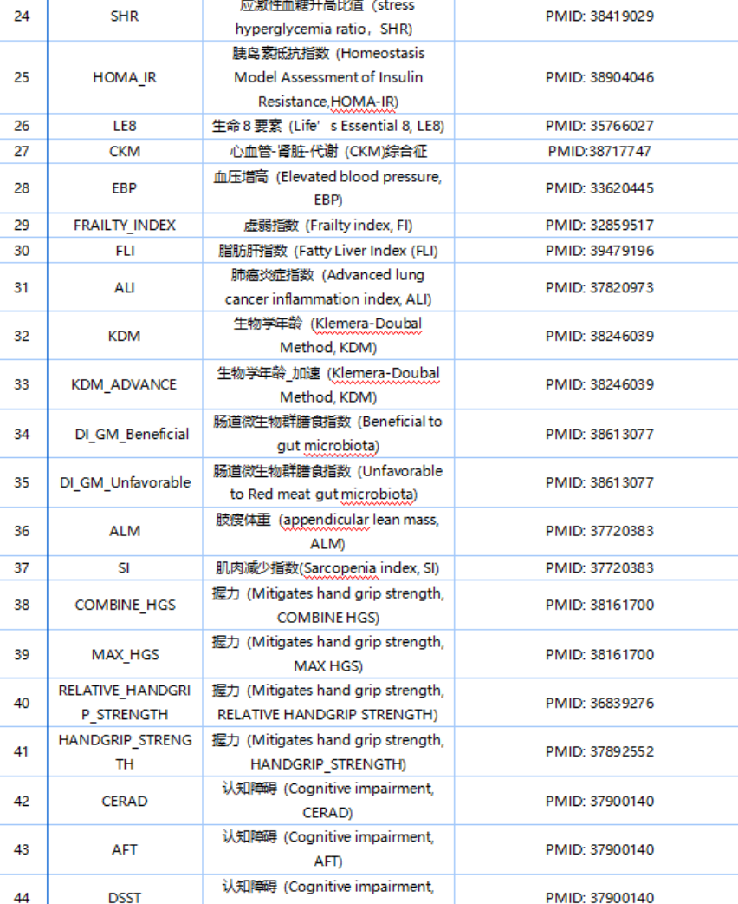
Feature Engineering

Slide 50
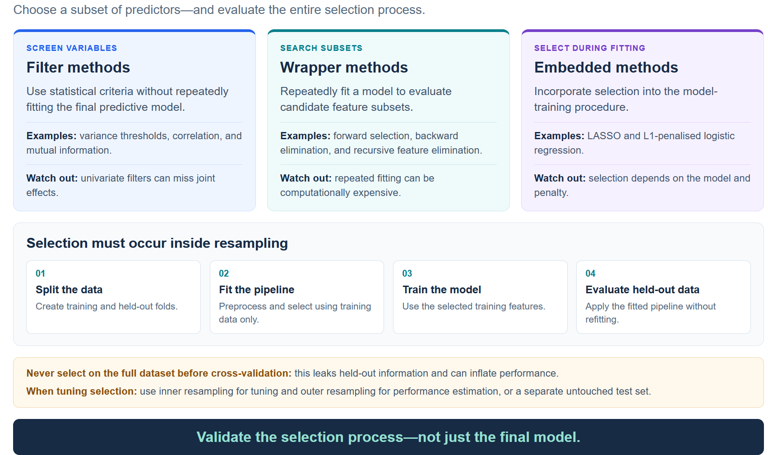
Feature Selection

Slide 51

Feature Selection versus Dimensionality Reduction

Slide 52
Code practice

